Slide 1

Stock Return Prediction using ARIMA model
By, Amith Mohan
PGCMDSFM03004

Slide 2

Data Source:
Historical Stock Price Data of INTERGLOBE AVIATION LTD (INDIGO)
Website : BSE
Time Period: 01-Feb-23 to 09-Mar-23

Slide 3
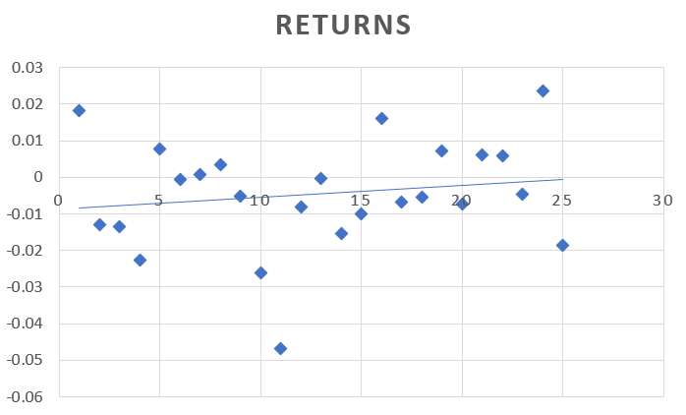
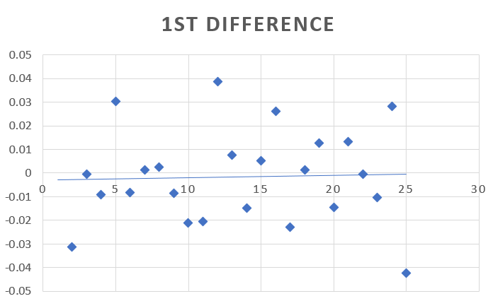
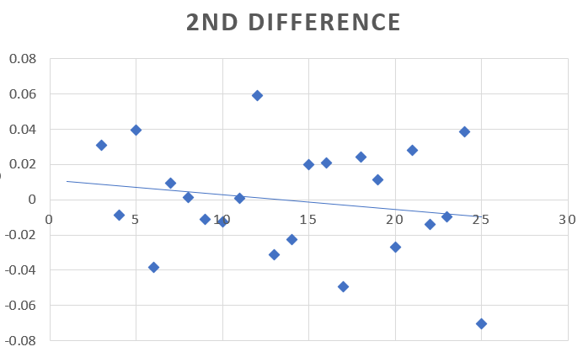
Returns Calculated from Close Price
Difference taken as the final data
After comparing the trends of the 3 graphs,
1 difference will be better to define the trend.
d = 1

Slide 4
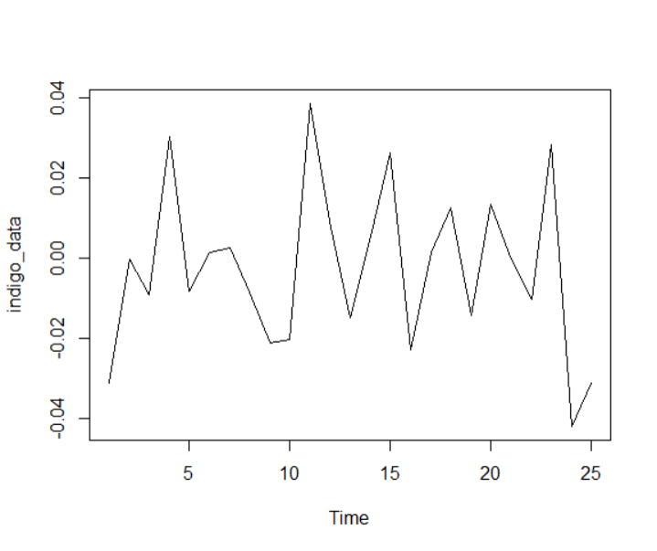
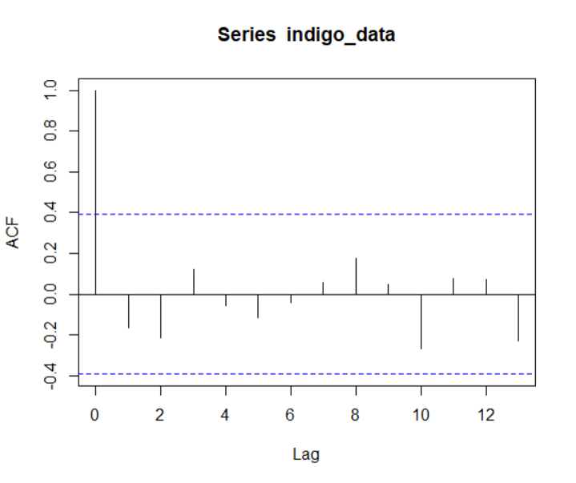
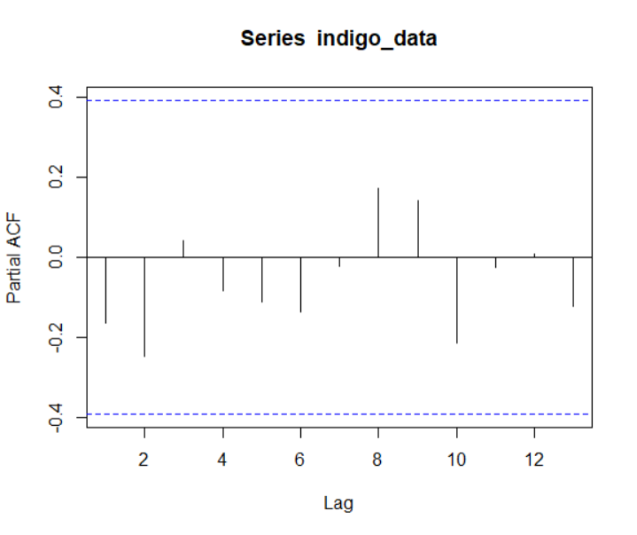
From the graphs , Both ACF and PACF shows cut-off after lag, so the model is AR or MA
Plot of the time series data
ACF (Autocorrelation Function)
PACF (Partial Autocorrelation Function)

Slide 5
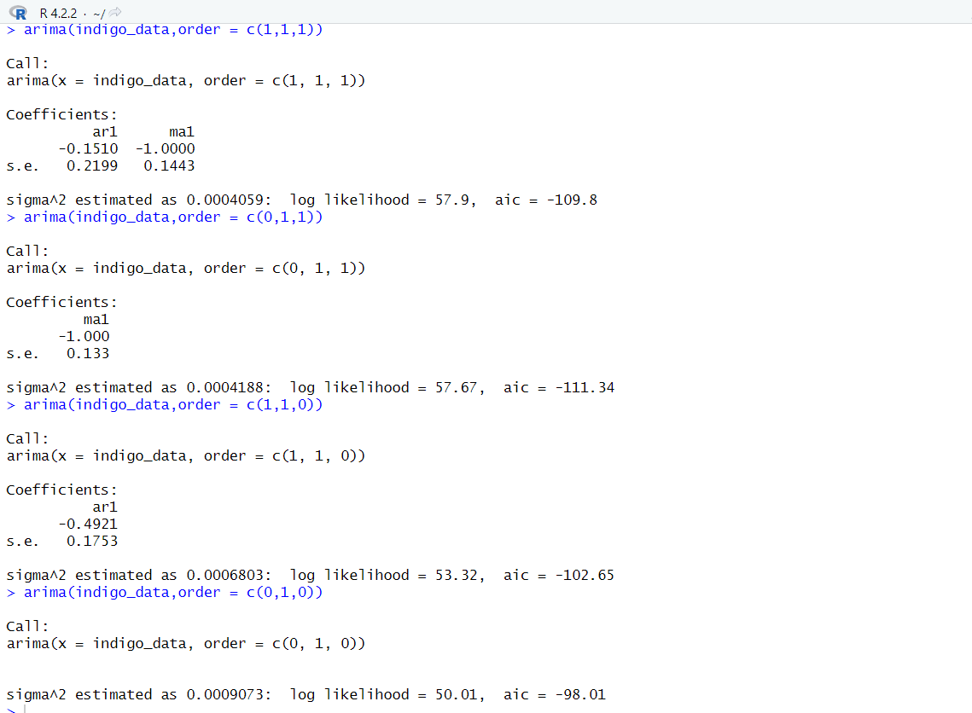
Evaluation of normal ARIMA model
Based on value of AIC ARIMA c(0,1,1) is better

Slide 6
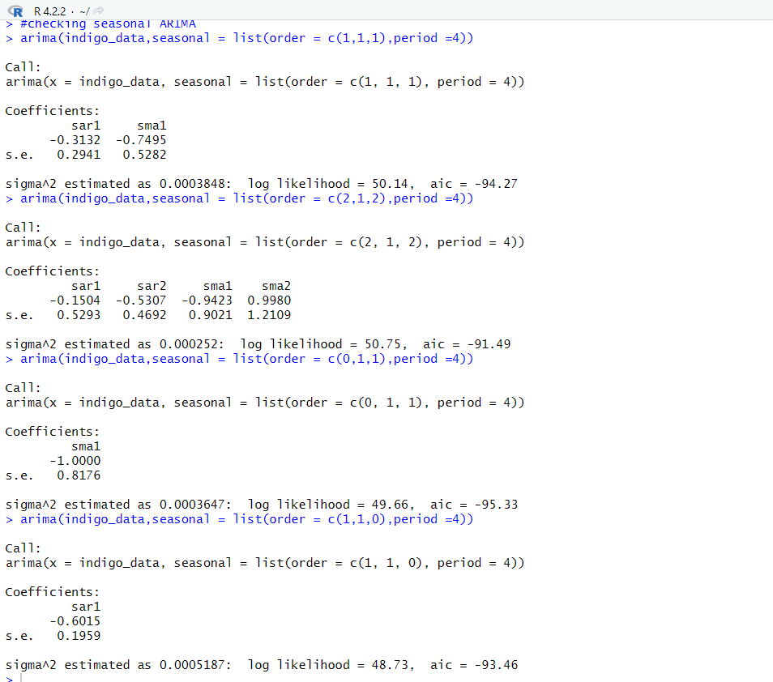
Evaluation of Seasonal ARIMA model
Based on value of AIC ARIMA c(0,1,1),period =4 is better

Slide 7
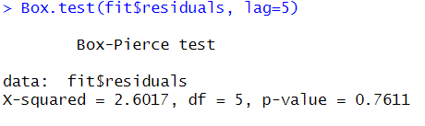
Model Validation – Box Test
Since p- value > 0.05, H0 is failed to be rejected

Slide 8
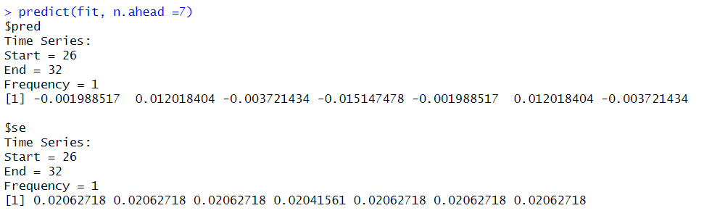
Predicted Returns for 7 days
Period | Predicted Returns | Standard Error
10-Mar-23 | -0.001988517 | 0.02062718
11-Mar-23 | 0.012018404 | 0.02062718
12-Mar-23 | -0.003721434 | 0.02062718
13-Mar-23 | -0.015147478 | 0.02041561
14-Mar-23 | -0.001988517 | 0.02062718
15-Mar-23 | 0.012018404 | 0.02062718
16-Mar-23 | -0.003721434 | 0.02062718

Slide 9
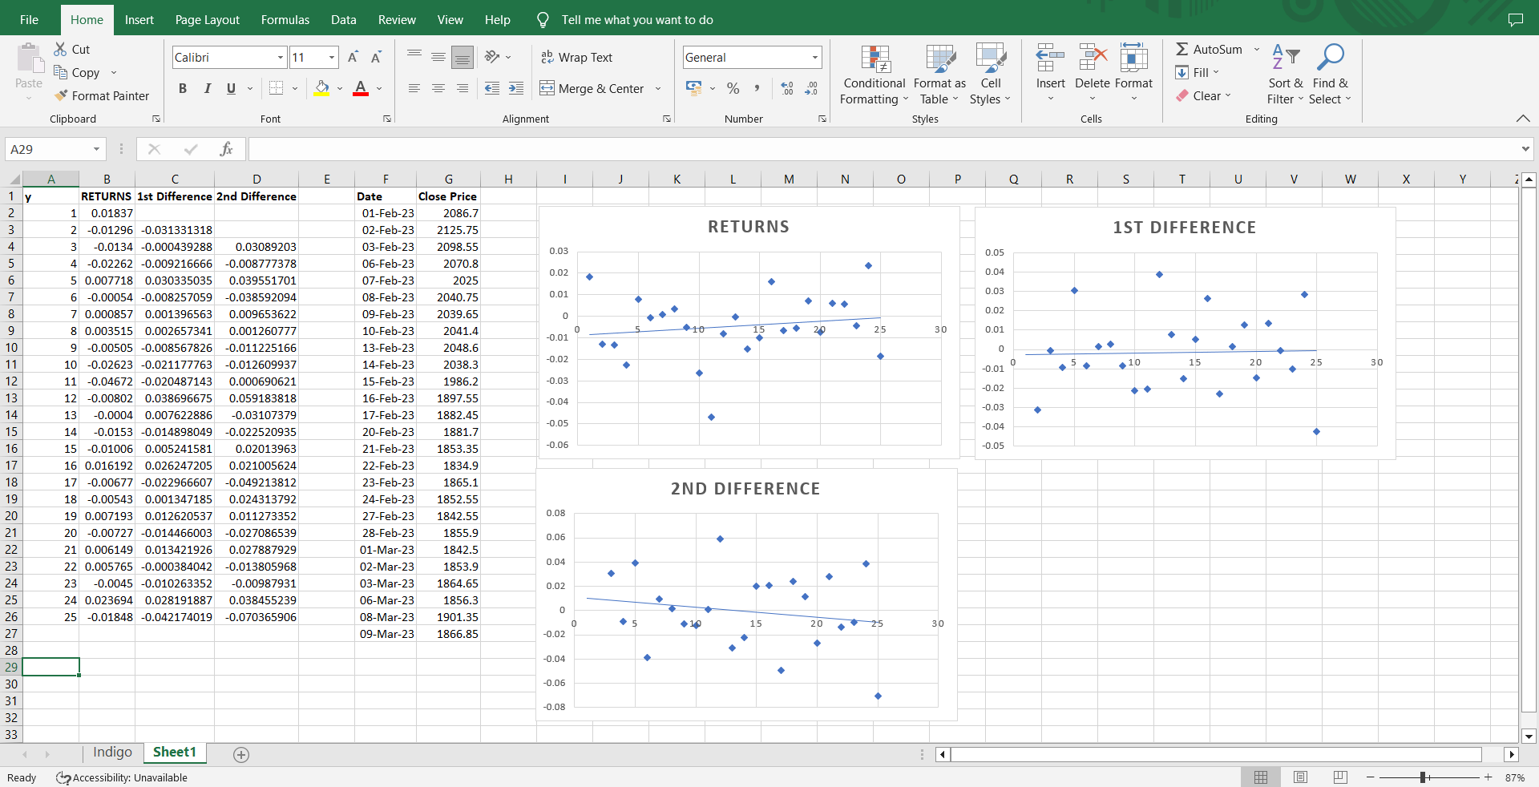
Excel Worksheet

Slide 10
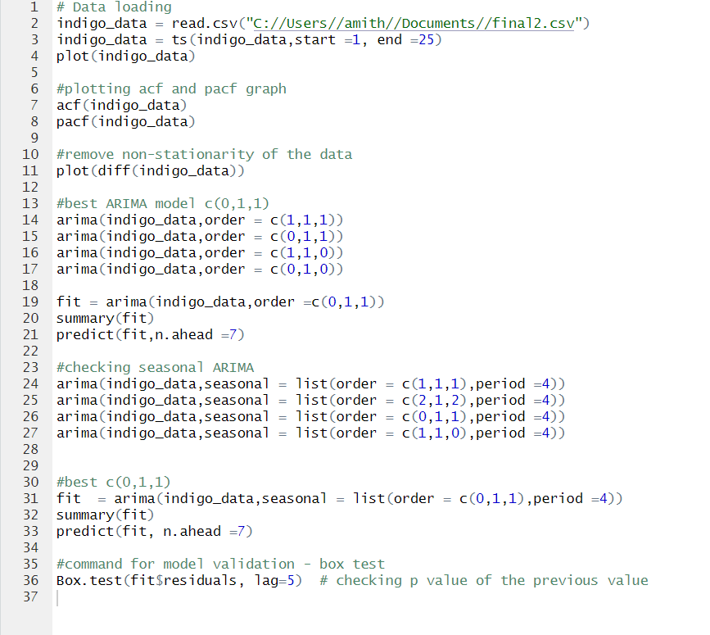
R - codes

Slide 11
THANK YOU

